Slide 1

Development of heteroleptic zinc(II) compounds of acylpyrazolone ligands with potential anticancer activity
Fabio Marchetti,ª Riccardo Pettinari,^{b} Claudio Pettinari,^{b} Corrado Di Nicola,ª Sabrina Morelli,^{c} Loredana De Bartolo,^{c} Iolinda Aiello,^{d} Alessandra Crispini,^{d}
ª University of Camerino, School of Science and Technology, Chemistry Section, Italy;
^{b} University of Camerino, School of Pharmacy, Chemistry Section, Italy;
^{c} Institute on Membrane Technology, National Research Council of Italy, ITM-CNR, c/o University of Calabria, Italy;
^{d} University of Calabria, Department of Chemistry and Chemical Technologies, Italy;
Abbreviated abstract: In recent years several Zn(II) complexes have been found to display anticancer activity with low in vivo toxicity, low side effects, and different cellular targets with respect to the classical metallodrugs.¹ Following previous studies on heteroleptic Zn(II) complexes bearing O,O- and N,N-chelating donor ligands,² here we explore new zinc complexes bearing acylpyrazolones, functionalized with hydrophobic groups, and ancillary N,N-chelating donors. Complexes were prepared in high yield by reacting [Zn(OAc)₂.2H₂O and the appropriate HQ^{R} proligand in methanol at room temperature, and their reaction with the chelating N₂-donor ligands in chloroform were tested.
Related publications:
- Drewry, J. A. et al, Coord. Chem. Rev. 255, 459-472 (2011)
- Pucci, D. et al, Dalton Trans., 42, 9679-9687, (2013)
F. Marchetti: fabio.marchetti@unicam.it - 1

Slide 2
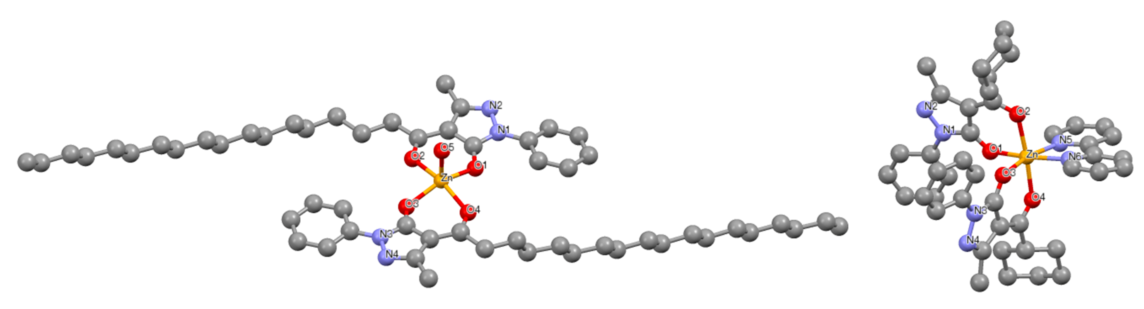
Figure 1. Proligands HQ^{R} and chelating N₂-donor ligands employed in this work.
Figure 2. Complexes 1-8.
The cytotoxicity of the HQ^{R} proligands and complexes 1-8 has been evaluated by determining the IC₅₀ values against human breast cancer MCF-7 cell line (Table 1). The results indicate that DMSO-dissolved complexes 2, 4 and 8 strongly inhibit the cell proliferation, with an IC₅₀ of 40, 24 and 38 μM, respectively, after 24 h; while complexes 1, 3, 5, 6 and 7 exhibit a lower cytotoxic activity.
Figure 3. X-ray molecular structures of complexes 1 (a) and 4 (b).
F. Marchetti: fabio.marchetti@unicam.it - 2

Slide 3
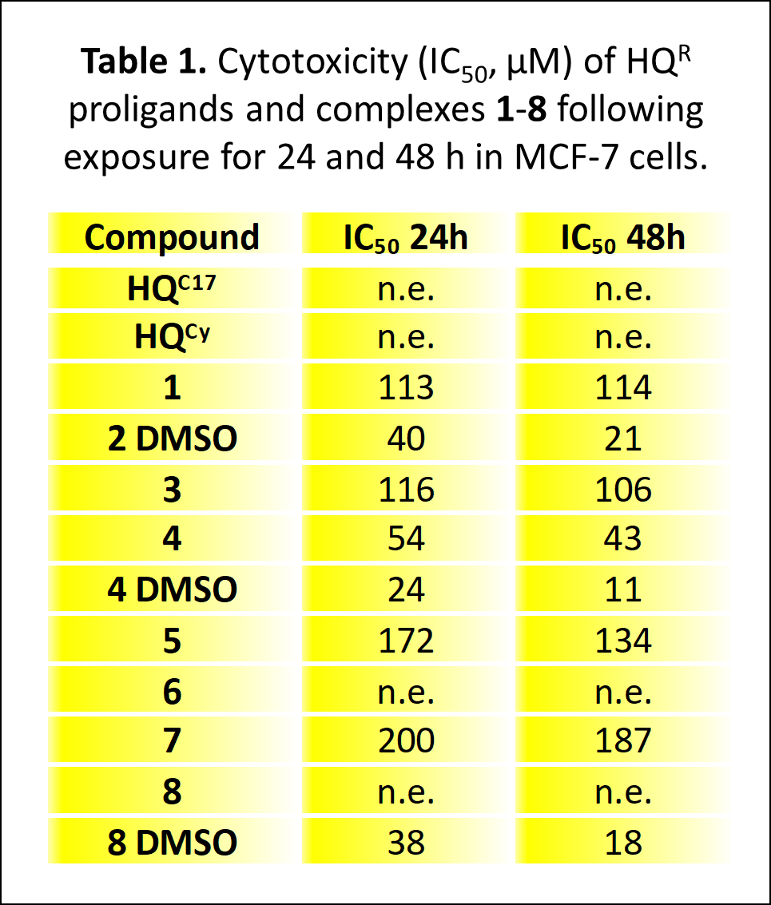
The viability of MCF-7 cells treated with different concentrations of the complexes has been assessed after 24 h by MTT test. Complexes 1 and 2 display a dose-dependent effect, and 100 μM complex 2 administration causes a drastic reduction of MCF-7 cell viability (1.3 ± 1%) (Figure 4a). Complexes 3 and 4 at low concentrations (1-10 μM) do not exhibit toxic effects, but the increase of complex 3 concentration to 50 μM induces a significant decrease in cell viability (59 ± 3%). Complex 4 dissolved in CHCl₃ shows an antiproliferative activity only at conc. of 100 μM but when it is dissolved in DMSO, a cytotoxic effect inducing cell death is already observed at conc. of 50 μM (Figure 4b).
Figure 4. Changes in the cell viability of MCF-7 cells after 24 h of treatment with various concentrations of 1 and 2 (a) and 3 and 4 (b).
F. Marchetti: fabio.marchetti@unicam.it - 3

Slide 4
Figure 5. Laser scanning confocal microscopy (LSCM) images of cells in the control (no treatment) and after treatment with complexes 1-5 at conc. of 50 μM. Cells were stained for apoptotic markers active caspase-3 (green), p-JNK (red) and nuclei (blue). Scale bar = 20 μm.
Two well defined markers of apoptosis, caspase-3 and phosphorylated N-terminal c-Jun protein kinase (p-JNK) in PCL membrane system of MCF-7 cells, are over-expressed after 24 h of treatment with the Zn(II) complexes 1, 2 and 4 (Figure 5).
The quantitative analysis (Figure 6) confirms the significant increase in levels of cleaved caspase-3 and p-JNK by MCF-7 cells after the treatment with complex 1, and DMSO-dissolved complexes 2 and 4.
Figure 6. Quantitative analysis of apoptotic markers caspase-3 (green bar) and p-JNK (red bar).
F. Marchetti: fabio.marchetti@unicam.it - 4

